Slide 1
INTERNSHIP 2024 SOLID PROPULSION
WEEK 3 PROGRESS REPORT

Slide 2
SECOND WEEK’S OBJECTIVES
Bolt calculation and decision on bolt design and material.
Conduct visual inspection of test stand.
Check ignition circuit.
Check data acquisition system.
Nozzle, bulkhead and casing fabrication for static test.
Check on O-ring for static test.
Design of concrete block protective shelter.

Slide 3
WEEK 2 TASKS COMPLETED

Slide 4
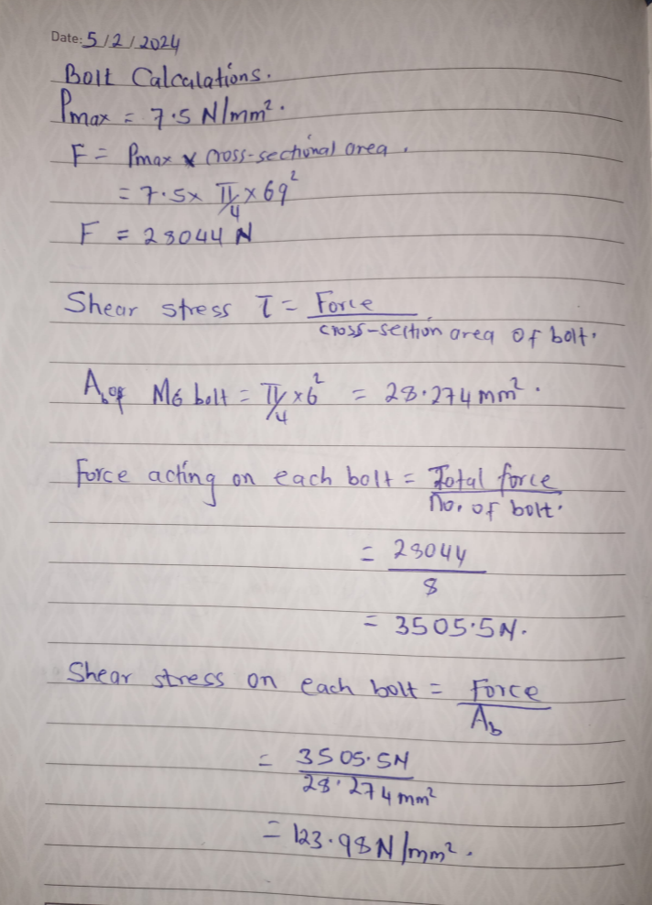
#2 Bolt calculation to determine shear stress.
Notes:
MONDAY 5TH

Slide 5
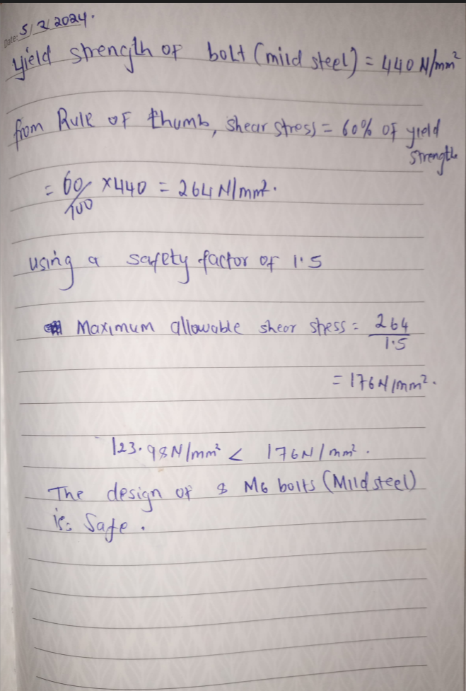
Continued :
Notes:
MONDAY 5TH

Slide 6
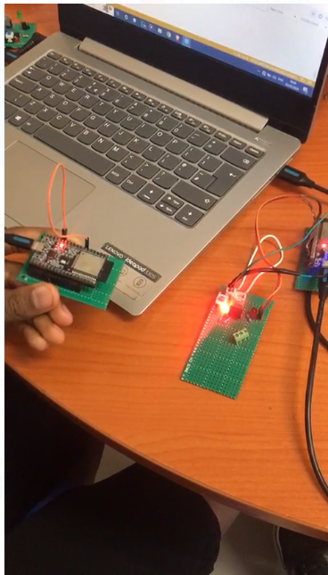
#32 Check the state of ignition circuit.
One circuit was in good condition i.e can be used in static test.
Notes:
MONDAY 5TH TEST COMMUNICATION OF ESP

Slide 7
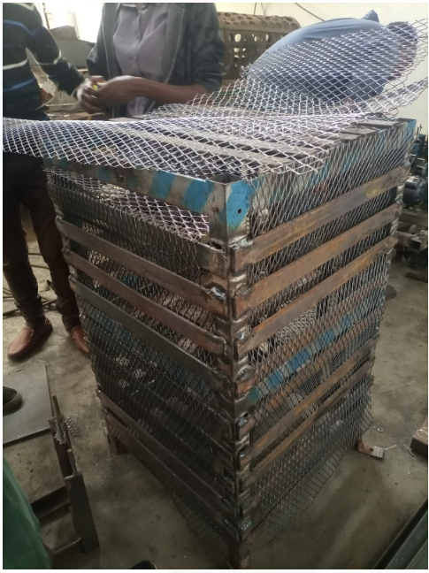
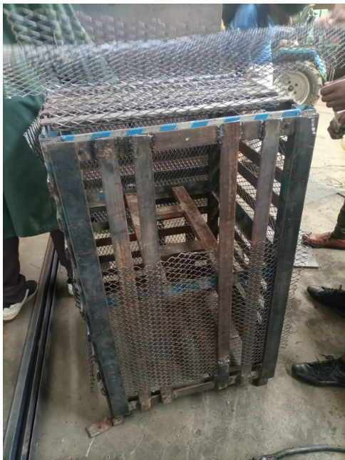
#38 Inspecting state of static test stand
Needed more welding - attach mesh and bulkhead attachment metal.
Needed grinding – Smoothen out weld
Notes:
MONDAY 5TH

Slide 8
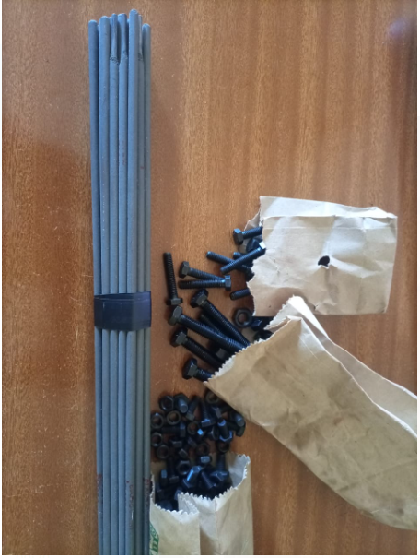
#39 PROCUREMENT OF BOLTS AND WELD RODS.
Notes:
TUESDAY 6TH M6 for casing and test stand and M8 for loadcell Mild steel bolts.

Slide 9
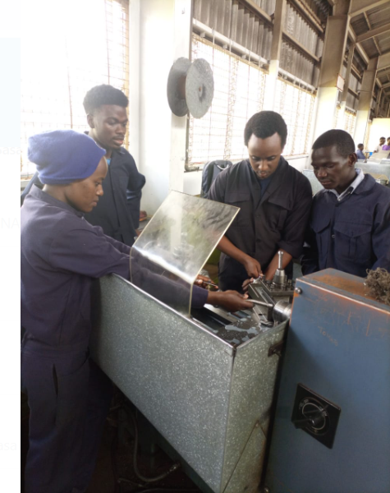
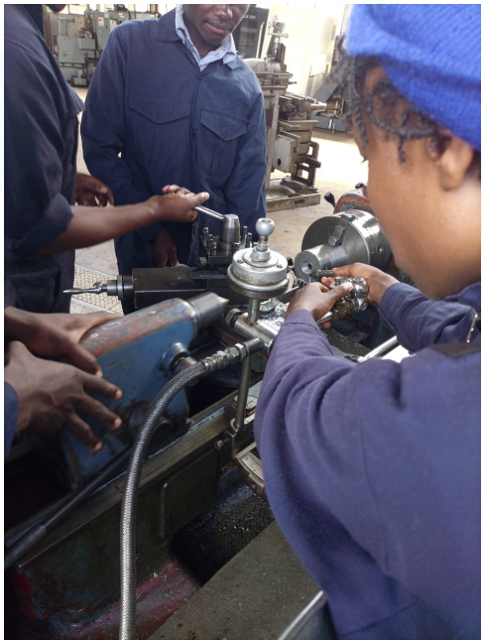
#37 MACHINING OF NOZZLE
Notes:
TUESDAY 6TH MACHINING BEGAN.

Slide 10
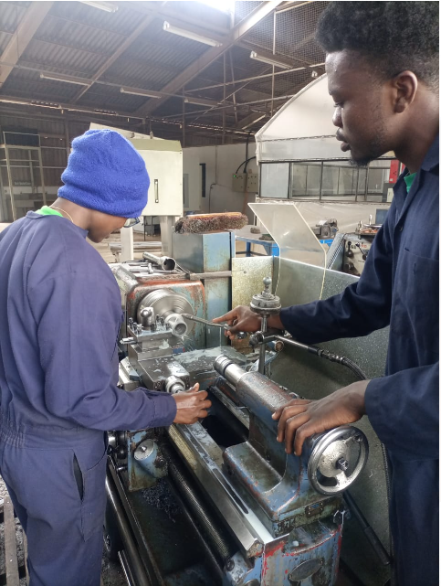
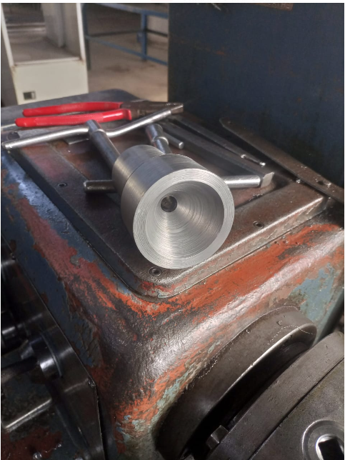
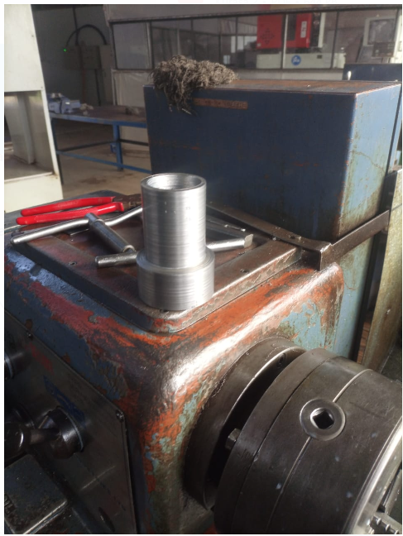
CONTINUED:
Notes:
WEDNESDAY 7TH CONTINUATION OF MACHINING

Slide 11
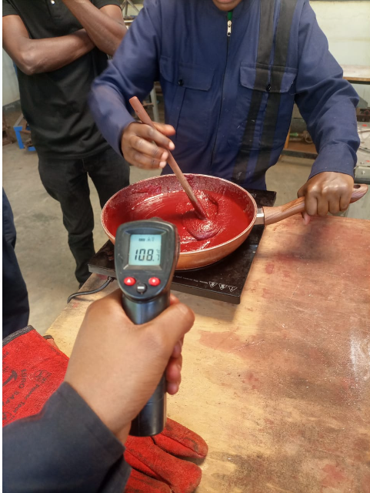
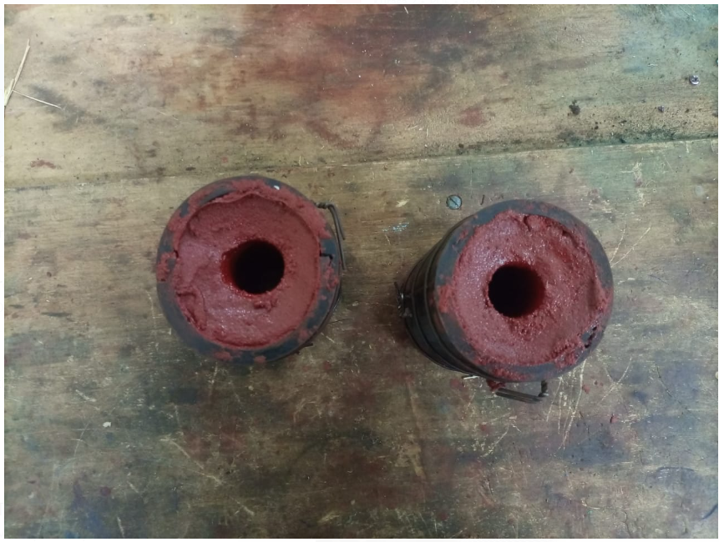
#40 COOKING OF GRAINS FOR STATIC TEST.
Notes:
TUESDAY 6TH :COOKED TWO GRAINS……total

Slide 12
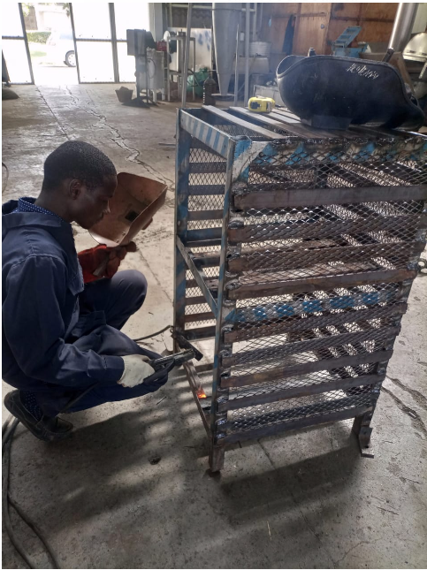
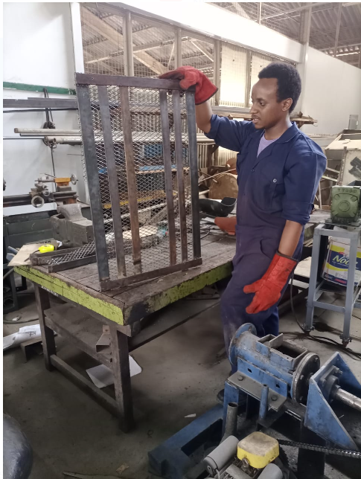
#38 WELDING OF STATIC TEST STAND AND ITS DOOR
Notes:
WEDNEDAY 7TH : Included welding of the mesh and the load cell bar and some minor finishes.

Slide 13
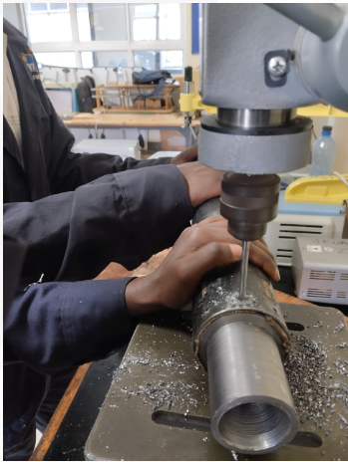
#42 DRILLING THE CASING AND NOZZLE
Notes:
8TH THURSDAY align holes – they all aligned,holes are M6

Slide 14
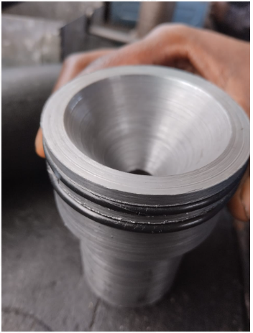
#43 FITTING O-RINGS
Notes:
FRIDAY 8TH O rings fit

Slide 15
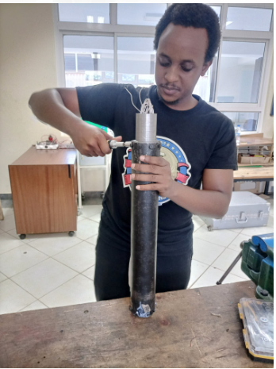
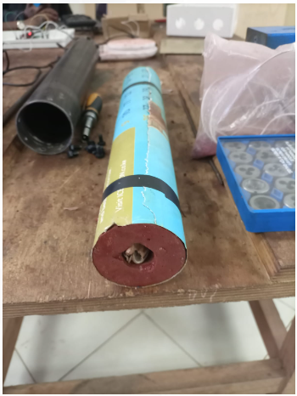
#47 FINAL MOTOR ASSEMBLY

Slide 16
WEEK 3 ACTIVITIES
Simulation of the flow through the nozzle. #44
Machining of more nozzles. #45
Analysis of static test results. #46

